Slide 1
UTILITY BILLING SYSTEM
By: Ananya Arisenapally

Slide 2
Project Overview
This project is a Utility Billing System designed to automate and manage utility services such as electricity, water, or gas billing in an efficient and scalable way.
The system allows consumers to view bills, make payments, and track usage, while enabling administrators to manage consumers, tariffs, and billing cycles.
It follows a microservices-based architecture, where each service handles a specific responsibility like consumer management, billing, or payments.
The application ensures accuracy, transparency, and reliability in billing while reducing manual effort and operational errors.

Slide 3
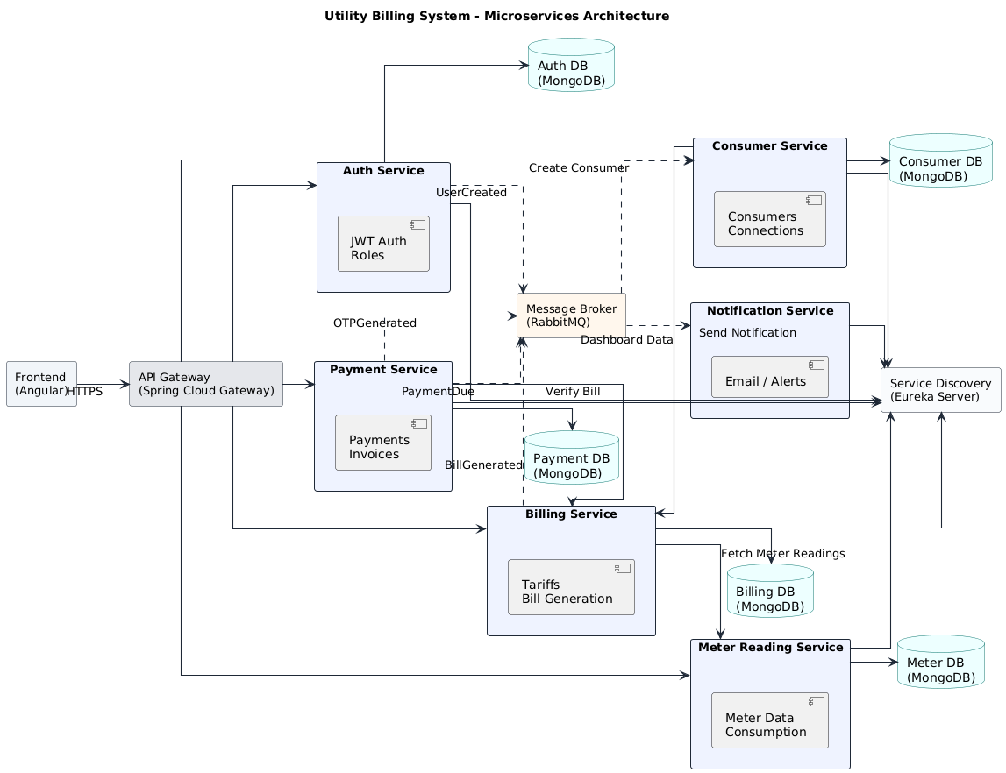
Microservices Architecture

Slide 4
Microservices Architecture Overview
The application is built using a microservices architecture, where each major function of the system is developed as an independent service. This helps the system remain flexible, scalable, and easy to maintain.
The Angular frontend acts as the user interface and communicates with the backend through a single entry point called the API Gateway, ensuring secure and organized request handling.
The API Gateway is responsible for routing user requests to the appropriate microservice, and managing load across services.
The Authentication Service handles user login, role validation, and JWT token generation, making sure only authorized users can access the system.
The Consumer, Meter Reading, Billing, and Payment Services each focus on a specific business function, allowing responsibilities to be clearly separated and managed efficiently.
These services communicate with each other through RESTful APIs using synchronous HTTP calls..
Eureka Server is used for service discovery, allowing services to dynamically find and communicate with each other without hardcoded URLs.
Each microservice maintains its own database, ensuring data isolation, better security, and independent scalability.

Slide 5
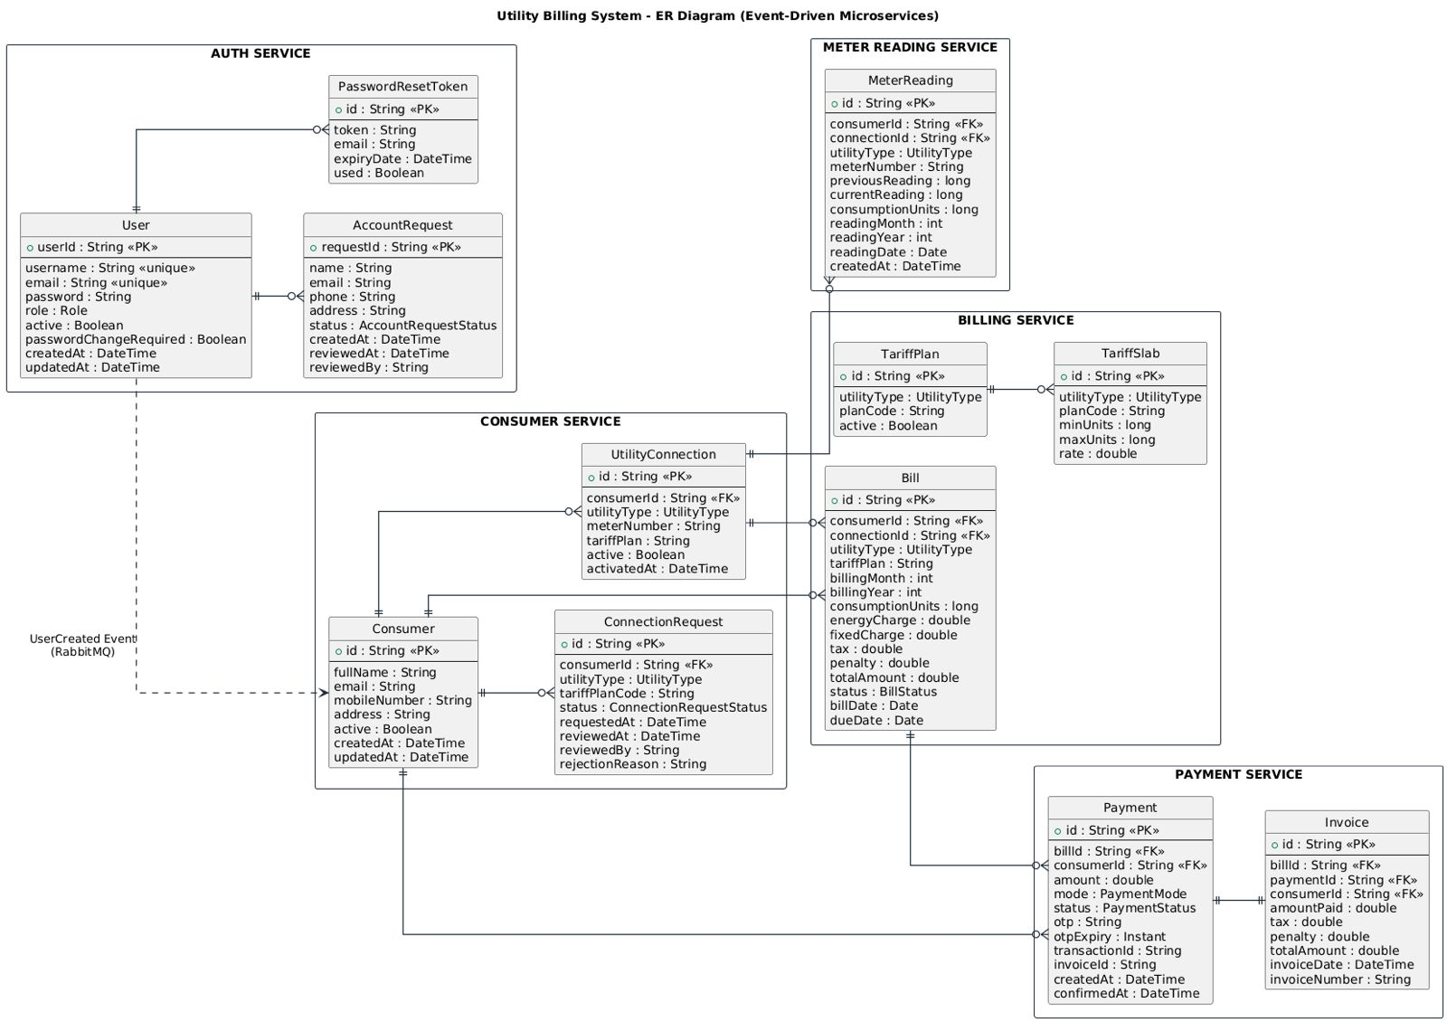
Entity-Relationship Diagram

Slide 6
Entity-Relationship Overview
Designed using microservice-based, event-driven architecture
Each service owns its independent database (no shared tables)
Ensures loose coupling, scalability, and fault isolation
Auth Service
Stores user credentials, roles, and password reset data
Acts as the security and access control layer
Consumer Service
Maintains consumer profiles and utility connection details
Handles connection requests and approvals
Meter Reading Service
Stores monthly meter readings
Calculates consumption units from previous and current readings
Billing Service
Manages tariff plans and slabs
Generates bills and tracks bill lifecycle (Generated, Due, Paid)

Slide 7
Entity-Relationship Overview
Payment Service
Stores payment and invoice records
Maintains transaction history and payment status
It also supports both mock online and offline payments for transactions.
Services communicate with each other using REST API through feign clients, while each service manages its own database independently.

Slide 8
Functional Roles and Responsibilities
Admin:
Manage users and roles (Admin, Billing Officer, Accounts Officer, Consumer)
Configure utility types and tariff plans
Oversee billing cycles and system configurations
Monitor overall system reports
Billing Officer:
Enter monthly meter readings
Validate meter data (previous vs current readings)
Generate bills based on consumption and tariff slabs
Accounts Officer:
Track bill payments
Monitor unpaid and overdue bills
View outstanding balances and revenue reports

Slide 9
Functional Roles and Responsibilities
Consumer:
View utility connections and personal profile
Access generated bills and payment history
Track consumption details
Receive bill and payment notifications

Slide 10
Security
Authentication
JWT (JSON Web Token) based authentication
Token generated on login and attached to each request
Stateless and scalable security mechanism
Authorization
Role-Based Access Control (RBAC)
Endpoint protection using roles:
Admin-only operations
Officer-level access
Consumer-restricted views

Slide 11
Application Life Cycle
Step 1: User Authentication & Access Control (All Roles)
User logs in through the Angular frontend
Credentials are verified by Auth Service
JWT token is generated and returned
Role-based access is applied:
Admin
Billing Officer
Accounts Officer
Consumer
Step 2: Consumer Onboarding & Connection Setup (Consumer → Admin)
Consumer registers and sends a request for account approval.
Consumer requests a utility connection
Admin reviews and approves the connection
Approved connection becomes active in the system

Slide 12
Application Life Cycle
Step 3: Meter Reading Entry (Billing Officer)
Billing Officer views active utility connections
Monthly meter readings are entered
System validates:
Previous reading
Current reading
Consumption units are automatically calculated
Step 4: Bill Generation (Billing Officer → System)
Billing Officer triggers bill generation
System calculates bill amount using:
Consumption units
Tariff slabs
Fixed charges and taxes
Bill status is set to Generated / Due
Bill becomes visible to the Consumer

Slide 13
Application Life Cycle
Step 5: Bill Review & Payment (Consumer → Accounts Officer)
Consumer views bill details and due amount
Consumer makes payment (mock online/offline)
Payment record is stored in the system
Bill status changes to Paid
Outstanding balance is updated
Step 6: Payment Tracking & Financial Monitoring (Accounts Officer)
Accounts Officer tracks:
Paid bills
Unpaid bills
Overdue bills
System calculates:
Total outstanding dues
Monthly revenue
Financial summaries are updated in dashboards

Slide 14
Application Life Cycle
Step 7: Dashboards & Reports (Admin & Officers)
Admin views system-wide dashboards
Billing & Accounts Officers view:
Revenue reports
Consumption analysis
Utility-wise summaries
Data supports operational and financial decisions
Step 8: Notifications & System Continuity (System → Users)
System sends notifications for:
Bill generation
Payment due reminders
Billing cycle repeats every month
Application continues with secure and auditable flow

Slide 15
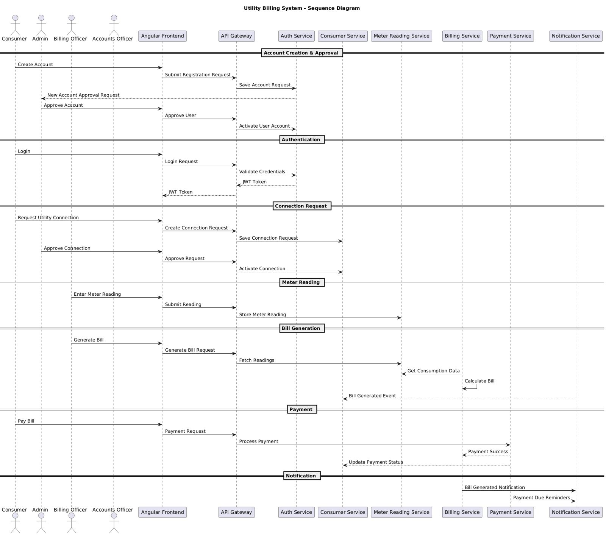
Sequence Diagram

Slide 16
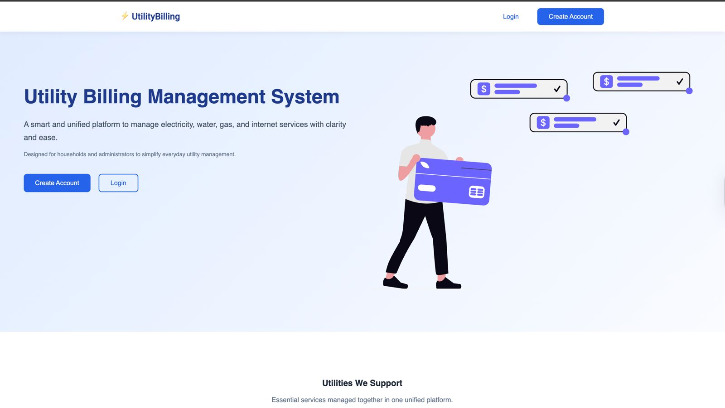
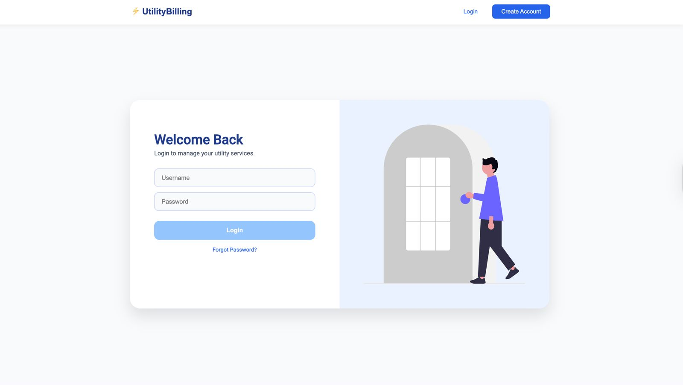
User Interface
Home Page (Common) | Login Page (Common)

Slide 17
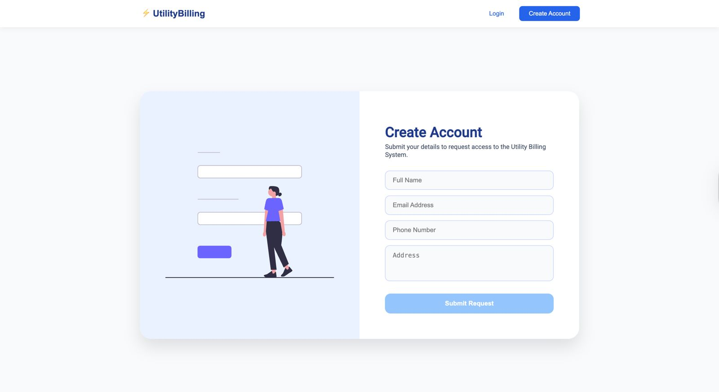
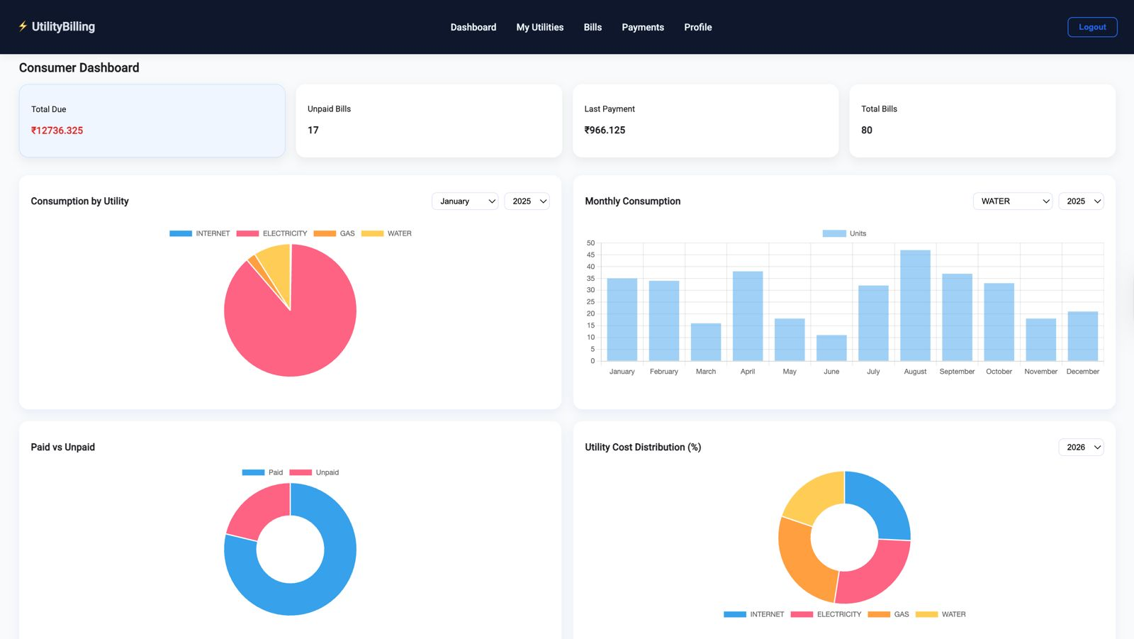
User Interface
SignUp Page (Common) | Consumer Dashboard (Consumer)

Slide 18
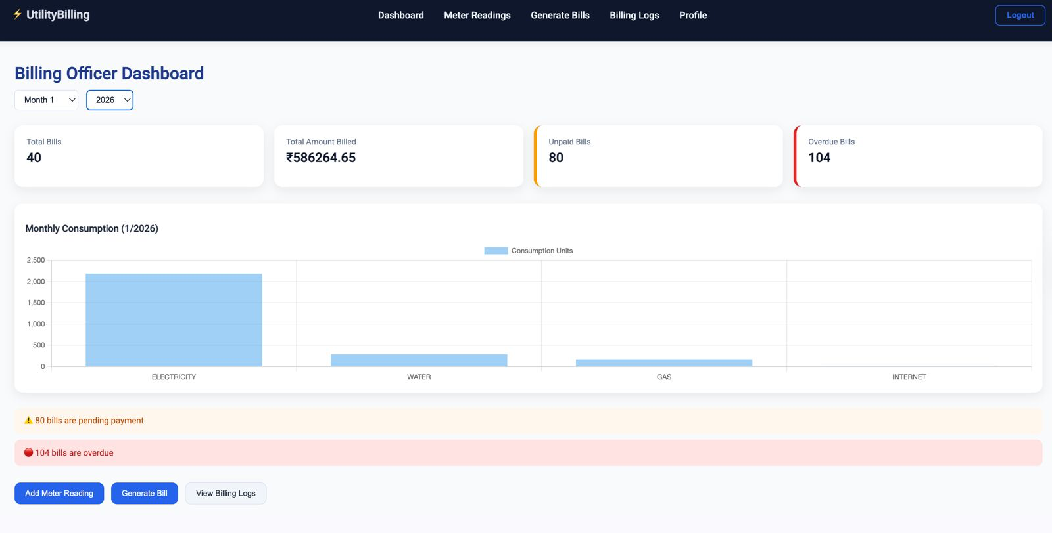
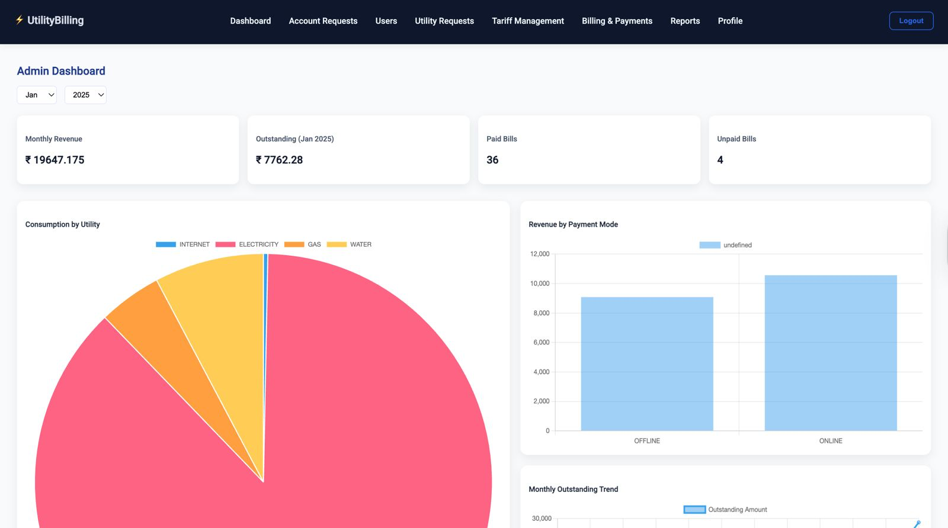
User Interface
Billing Officer Dashboard (Billing Officer) | Admin Dashboard (Admin)

Slide 19
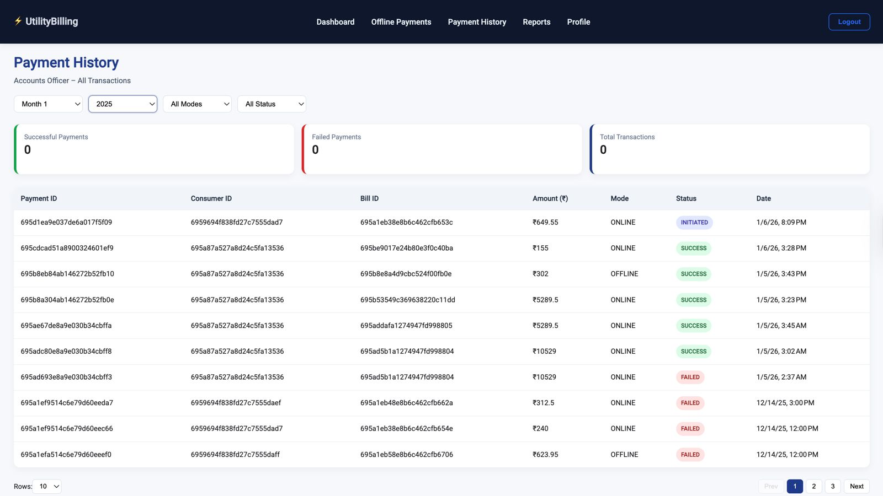
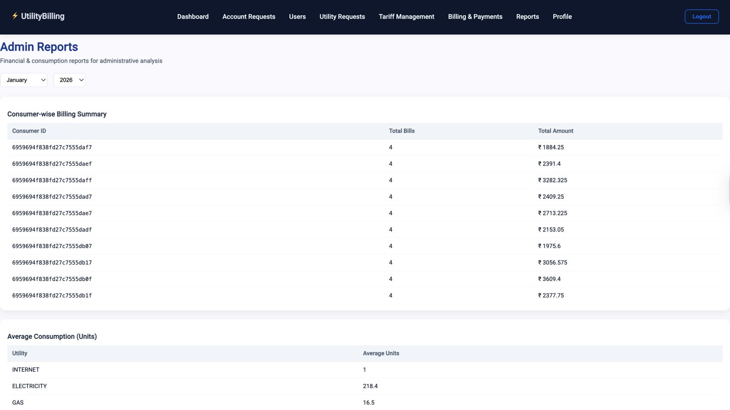
User Interface
Payment History (Billing Officer) | Admin Reports (Admin)

Slide 20
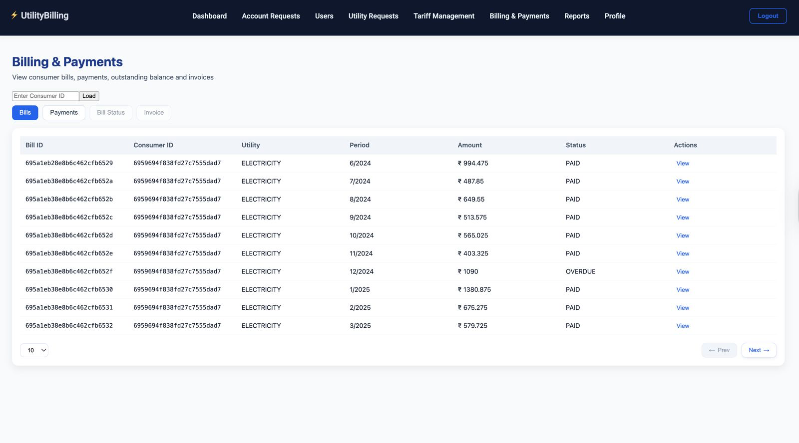
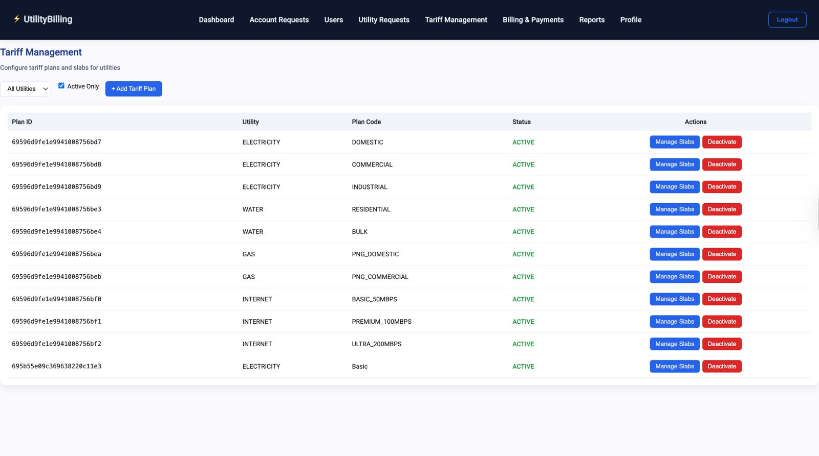
User Interface
Billing and Payments (Admin) | Tariff Management (Admin)

Slide 21
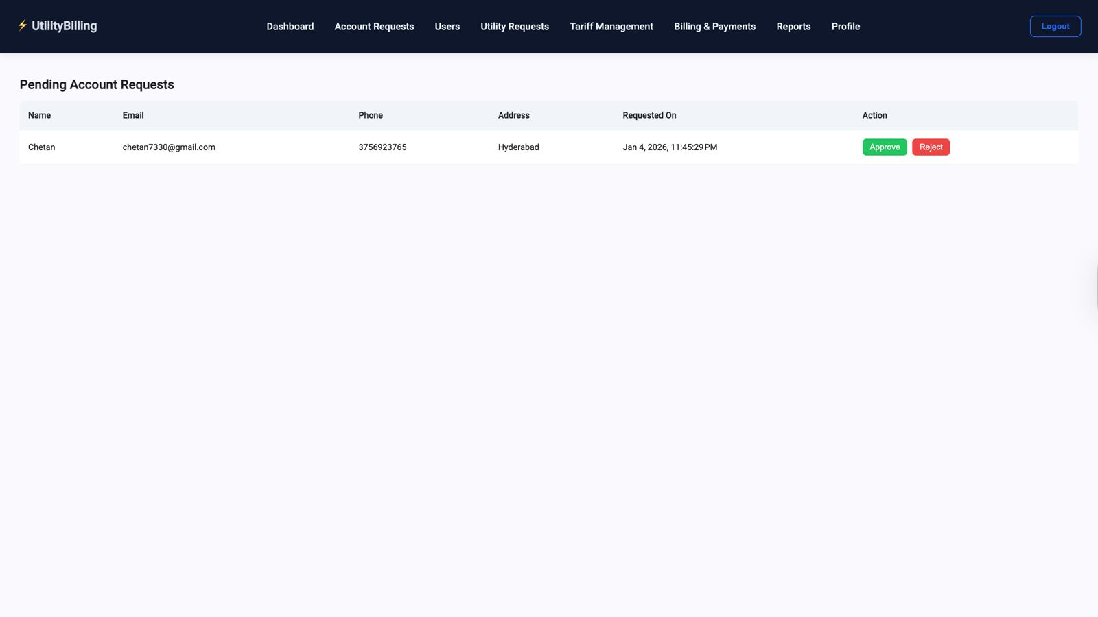
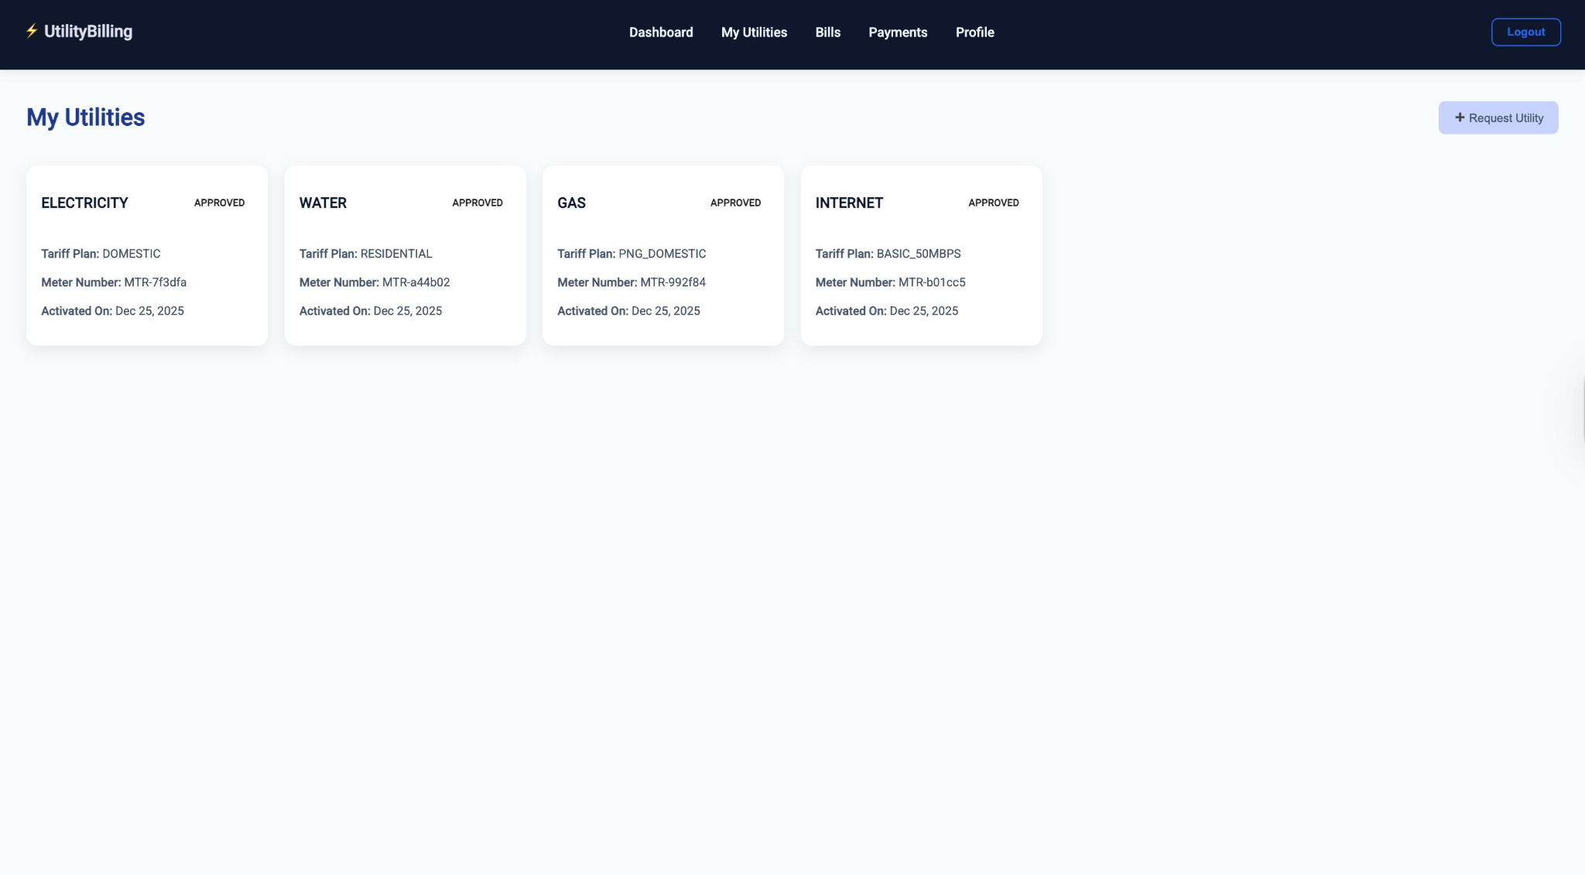
User Interface
Pending Account Requests (Admin) | My Utilities (Consumer)

Slide 22
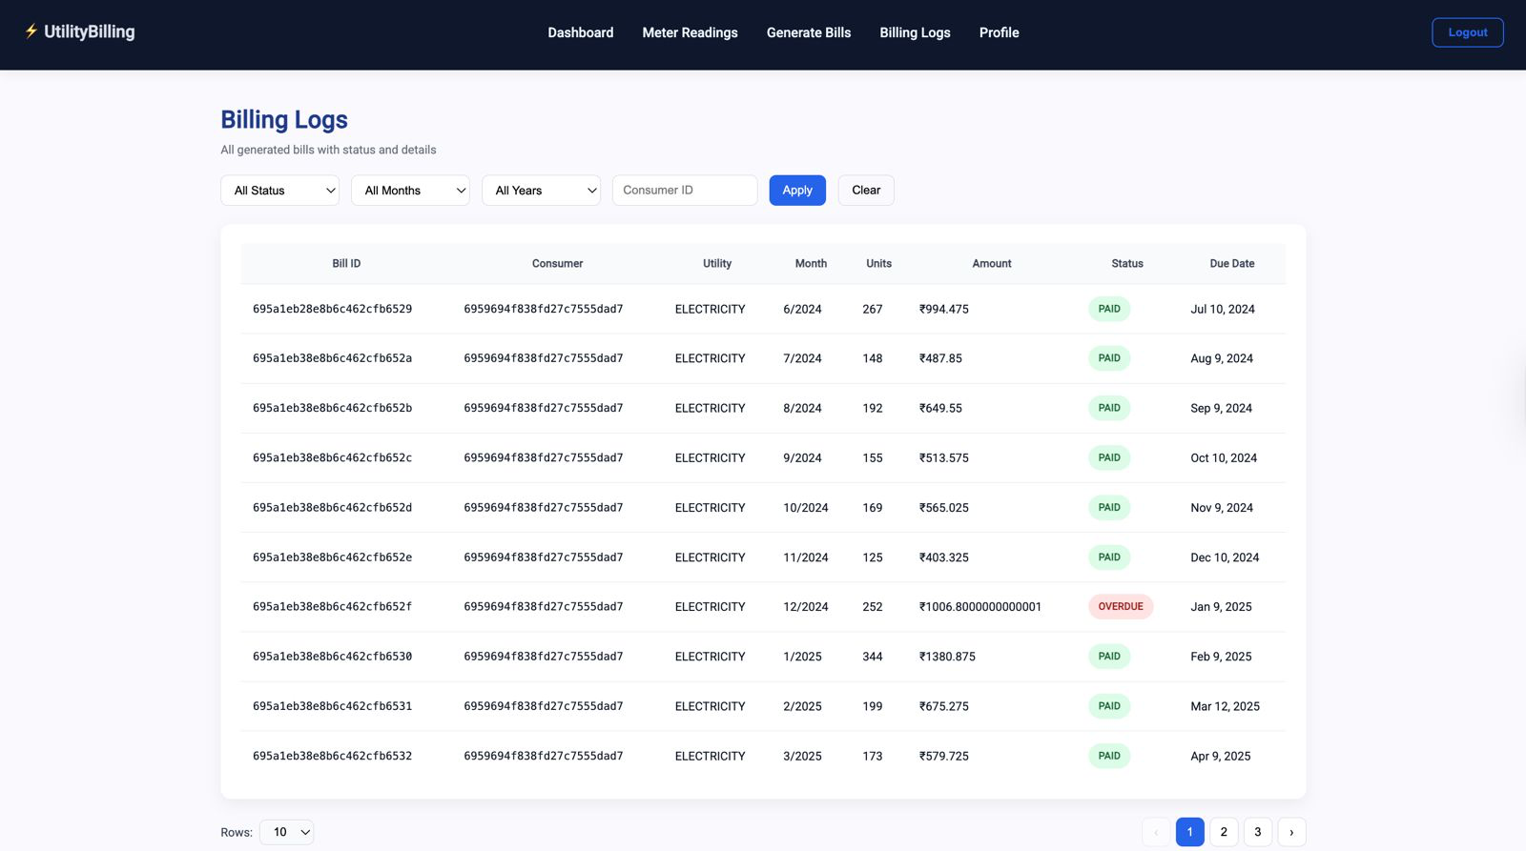
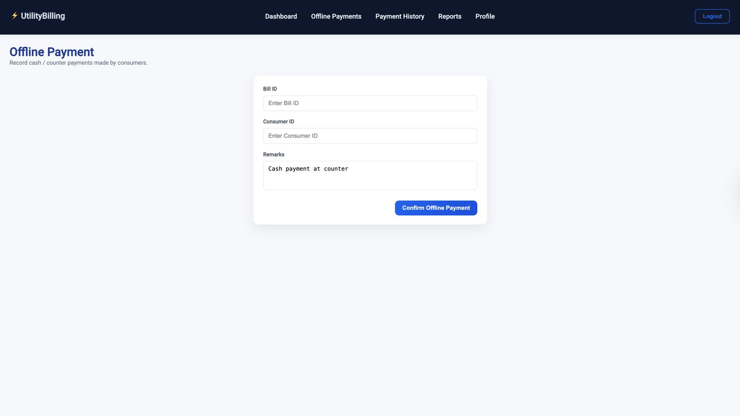
User Interface
Billing Logs (Billing Officer) | Offline Payment (Accounts Officer)

Slide 23
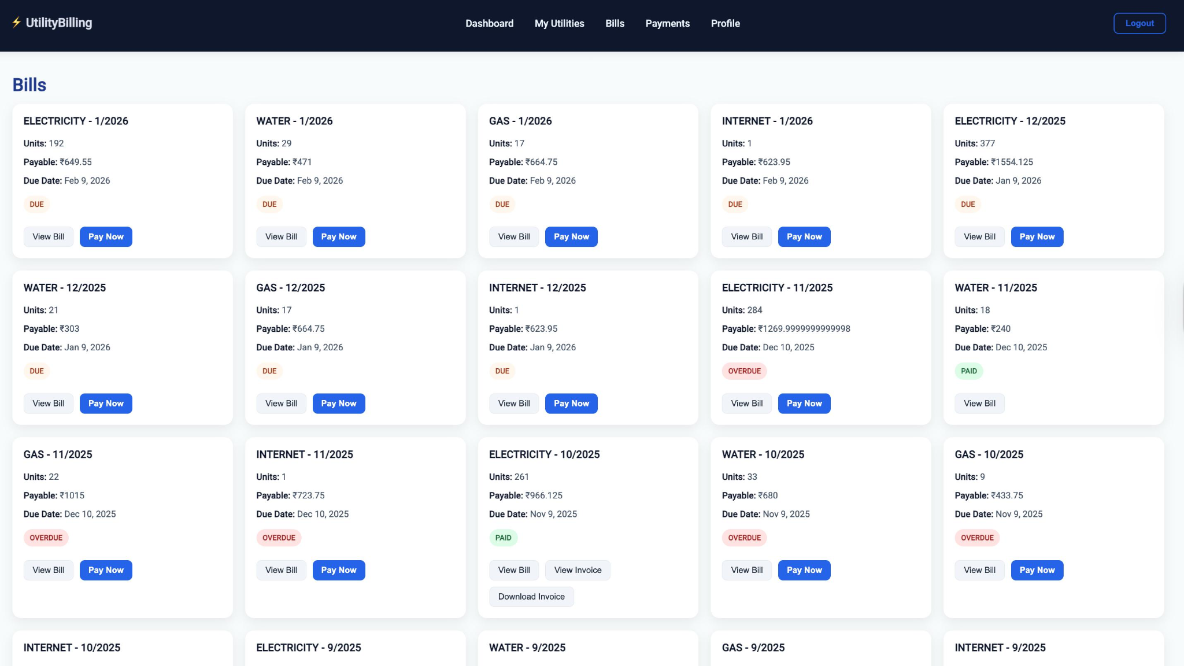
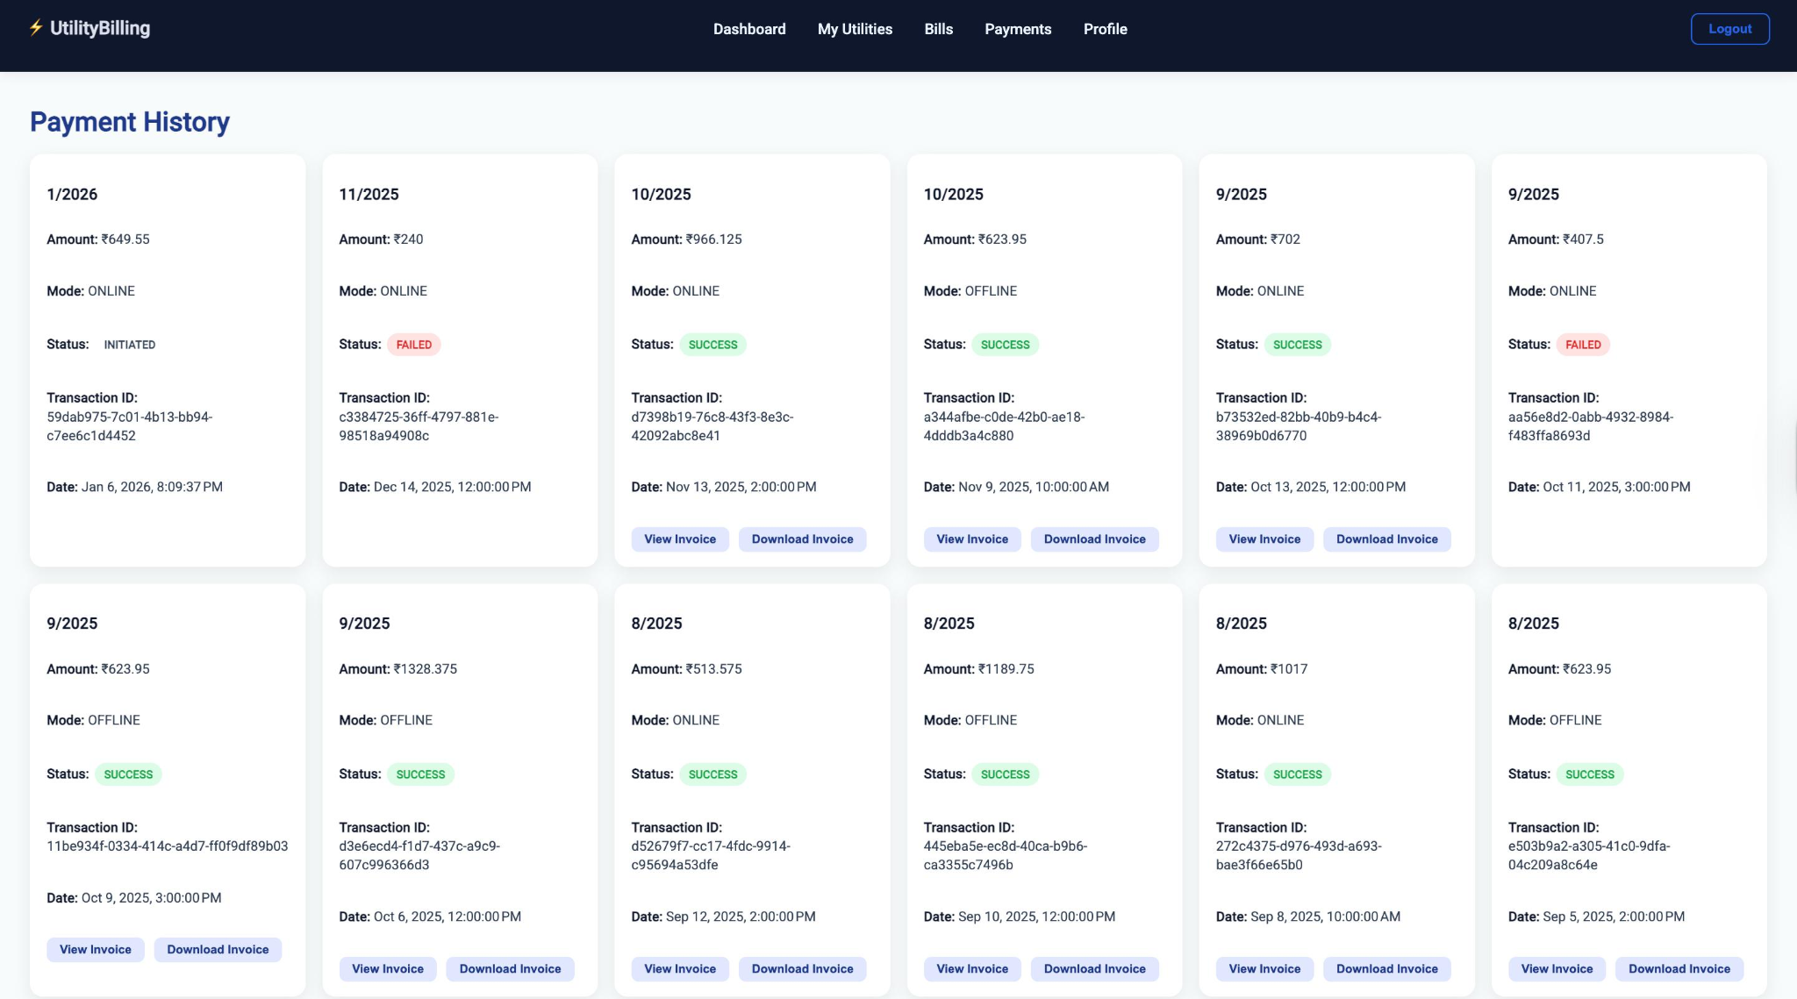
User Interface
Bills (Consumer) | Payments (Consumer)

Slide 24
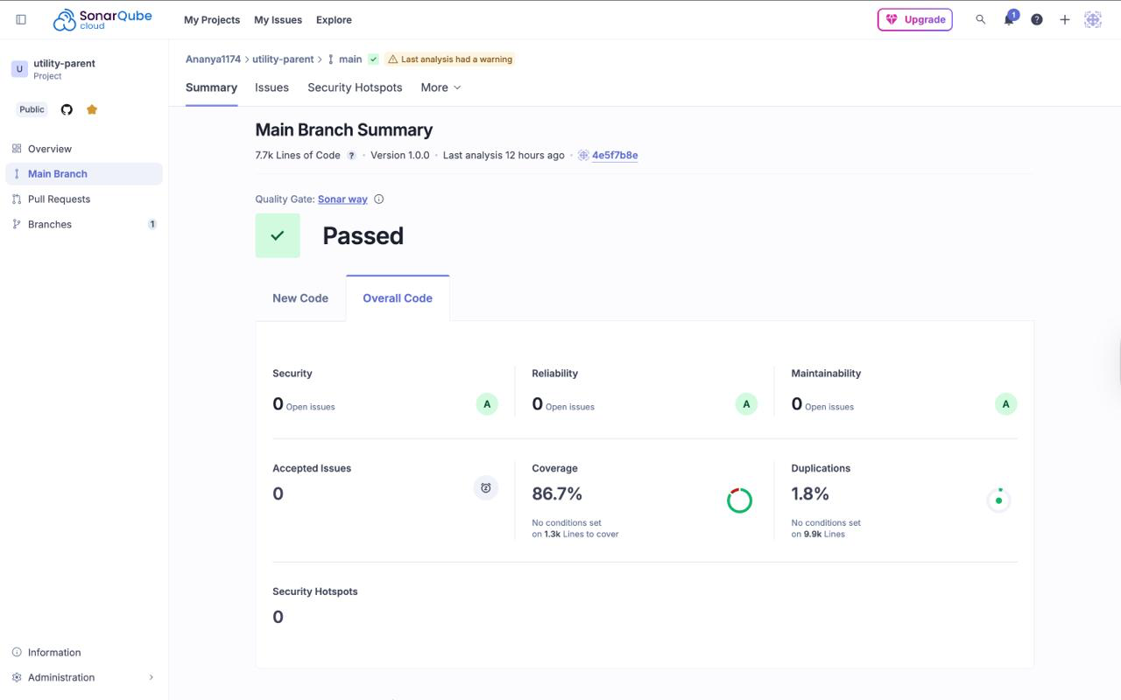
SonarQube Dashboard

Slide 25
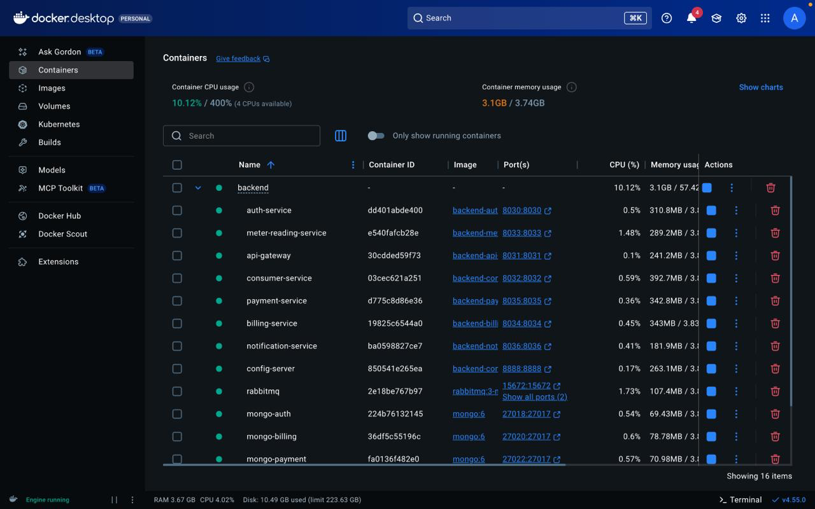
Docker Containers

Slide 26
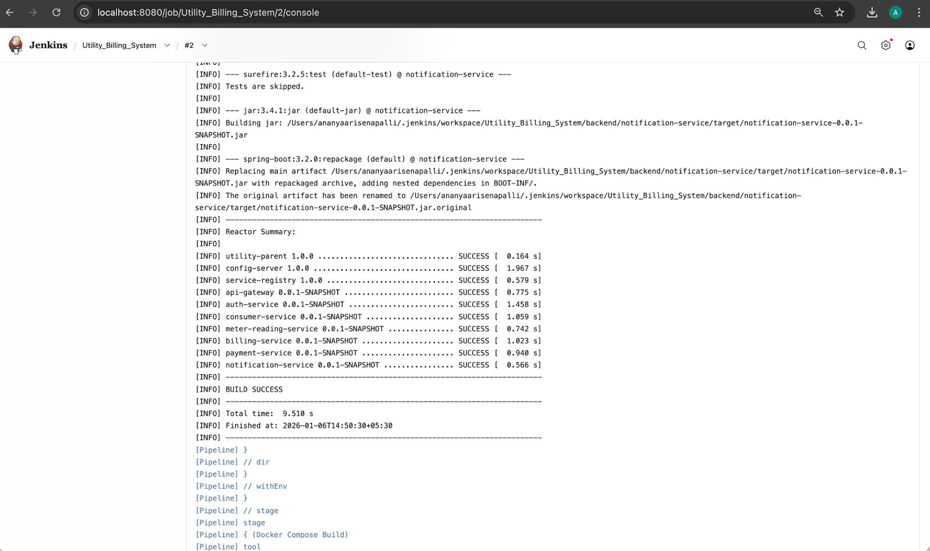
Jenkins Build Logs

Slide 27
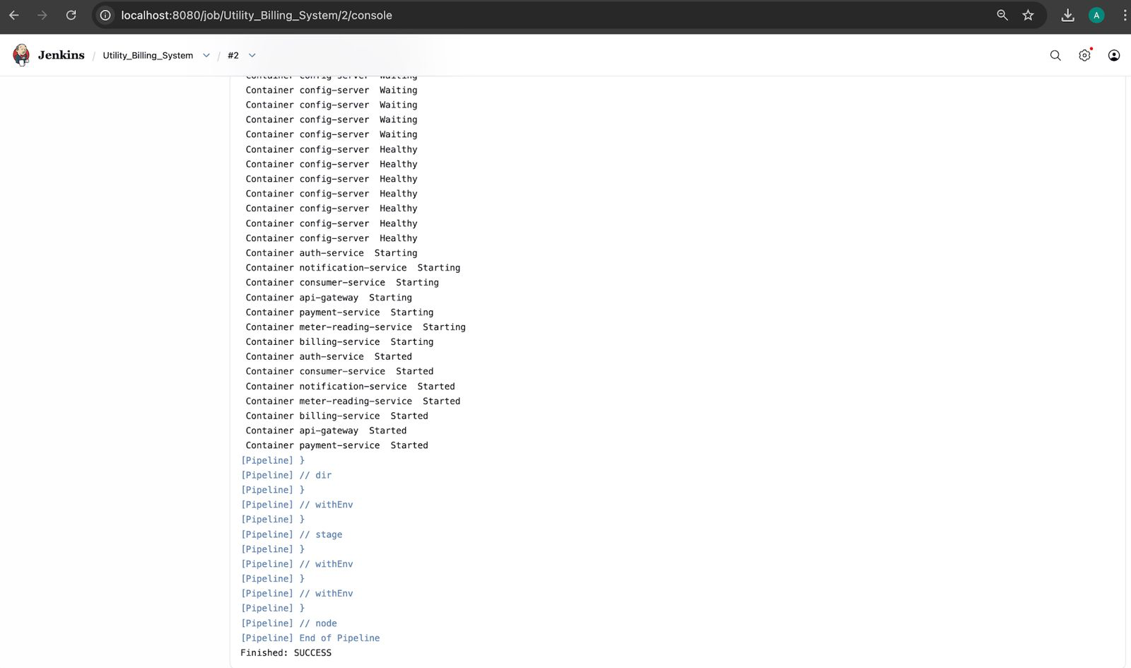
Jenkins Build Logs

Slide 28
Conclusion
This project successfully delivers a robust and scalable Utility Billing System that automates the end-to-end billing lifecycle for utility services. By integrating a user-friendly frontend with a secure and modular backend, the system simplifies complex billing operations while ensuring accuracy, transparency, and reliability.
The application effectively supports role-based access, enabling administrators, utility providers, and consumers to interact with the system according to their responsibilities. Key functionalities such as consumer management, bill generation, payment processing, and usage tracking are handled seamlessly, reducing manual effort and operational errors.
Strong emphasis has been placed on security and data integrity, with proper authentication, authorization, and validation mechanisms implemented across the system. The use of structured database design and RESTful APIs ensures maintainability, scalability, and smooth communication between services.
Overall, this project demonstrates a real-world, production-ready solution that aligns with modern software engineering practices. It can be further enhanced with features like real-time notifications, analytics dashboards, and cloud deployment, making it suitable for large-scale utility management systems.

